Slide 1


Python Programming Ⅰ
week 5

Slide 2
Python: Control Flow while Statement

Slide 3
Topic Structure
Task | Single Value | Multiple Values | numpy, pandas
Presentation (value, variable) | int, float, string, boolean | list, tuple, dictionary, set | ndarray, Series, DataFrame
Operation (algebra) | expressions | operations, mutable operations | expressions, get, set, reshape, …
Control flow | if for while
Use and reuse | Functions Standard libraries Modules and Packages
Input and output | Standard I/O File I/O |  | Standard I/O File I/O CSV, Excel

Slide 4
Learning Objectives
while Statement
while
Control Flow in while Statement
Repetition Controls for while Statement
The break Statement
while-else
while-if
while-while (nested while)

Slide 5
The while Statement
The while statement allows you to repeatedly execute a block of statements as long as a condition is true.
A while statement is an example of what is called a looping statement.
A while statement can have an optional else clause.
When included, it is always executed once after the while loop is over unless a break statement is encountered.

Slide 6
Syntax of while Statement
while expression:
statements1
else: # optional
statements2 # optional

Slide 7
Variation: while
while expression:
statements1
else: # optional
statements2 # optional

Slide 8
Variation: while-else
while expression:
statements1
else: # optional
statements2 # optional

Slide 9
Learning Objectives
while Statement
while
Control Flow in while Statement
Repetition Controls for while Statement
The break Statement
while-else
while-if
while-while (nested while)

Slide 10
Flow Diagram: while
while expression:
statements
expression
If expression is true
If expression is false
statements

Slide 11
Control Flow in while
while expression:
statements

Slide 12
Control Flow in while
while expression:
statements

Slide 13
Control Flow in while
while expression: # True
statements

Slide 14
Control Flow in while
while expression: # True
statements

Slide 15
Control Flow in while
while expression: # True
statements # Go to 'while expression'

Slide 16
Control Flow in while
while expression:
statements

Slide 17
Control Flow in while
while expression: # False
statements

Slide 18
Control Flow in while
while expression: # False
statements
# Terminate

Slide 19
Example: Control Flow in while
Print out the integers from 1 to 3.
i = 1
while i <= 3:
print(i)
i += 1

Slide 20
Example: Control Flow in while
Print out the integers from 1 to 3.
i = 1
while i <= 3:
print(i)
i += 1

Slide 21
Example: Control Flow in while
Print out the integers from 1 to 3.
i = 1
while i <= 3:
print(i)
i += 1

Slide 22
Example: Control Flow in while
Print out the integers from 1 to 3.
i = 1
while i <= 3: # 1 <= 3 → True
print(i)
i += 1

Slide 23
Example: Control Flow in while
Print out the integers from 1 to 3.
i = 1
while i <= 3: # 1 <= 3 → True
print(i)
i += 1

Slide 24
Example: Control Flow in while
Print out the integers from 1 to 3.
i = 1
while i <= 3: # 1 <= 3 → True
print(i)
i += 1 # Go to ' while i <= 3 '

Slide 25
Example: Control Flow in while
Print out the integers from 1 to 3.
i = 1
while i <= 3:
print(i)
i += 1

Slide 26
Example: Control Flow in while
Print out the integers from 1 to 3.
i = 1
while i <= 3: # 2 <= 3 → True
print(i)
i += 1

Slide 27
Example: Control Flow in while
Print out the integers from 1 to 3.
i = 1
while i <= 3: # 2 <= 3 → True
print(i)
i += 1

Slide 28
Example: Control Flow in while
Print out the integers from 1 to 3.
i = 1
while i <= 3: # 2 <= 3 → True
print(i)
i += 1 # Go to ' while i <= 3 '

Slide 29
Example: Control Flow in while
Print out the integers from 1 to 3.
i = 1
while i <= 3:
print(i)
i += 1

Slide 30
Example: Control Flow in while
Print out the integers from 1 to 3.
i = 1
while i <= 3: # 3 <= 3 → True
print(i)
i += 1

Slide 31
Example: Control Flow in while
Print out the integers from 1 to 3.
i = 1
while i <= 3: # 3 <= 3 → True
print(i)
i += 1

Slide 32
Example: Control Flow in while
Print out the integers from 1 to 3.
i = 1
while i <= 3: # 3 <= 3 → True
print(i)
i += 1 # Go to ' while i <= 3 '

Slide 33
Example: Control Flow in while
Print out the integers from 1 to 3.
i = 1
while i <= 3:
print(i)
i += 1

Slide 34
Example: Control Flow in while
Print out the integers from 1 to 3.
i = 1
while i <= 3: # 4 <= 3 → False
print(i)
i += 1

Slide 35
Example: Control Flow in while
Print out the integers from 1 to 3.
i = 1
while i <= 3: # 4 <= 3 → False
print(i)
i += 1
# Terminate

Slide 36
Indentation
while expression:
statements
expression
If expression is true
If expression is false
statements

Slide 37
Learning Objectives
while Statement
while
Control Flow in while Statement
Repetition Controls for while Statement
The break Statement
while-else
while-if
while-while (nested while)

Slide 38
Cases of Repetition Controls for while Statement
The cases in which number of iterations is fixed.
The cases in which number of iterations is not fixed.
A flag variable
The break statement
Infinite loop (error)

Slide 39
Example: Fixed Number of Iterations
Print out the integers from 1 to 100.
i = 1
while i <= 100:
print(i)
i += 1

Slide 40
Example: Fixed Number of Iterations
Print out the integers from 0 to 99.
i = 0
while i < 100:
print(i)
i += 1

Slide 41
Example: Fixed Number of Iterations
Print out the integers from 0 to 99.
i = 0
while i < 100:
print(i)
i += 1
Print out the integers from 0 to 99.
i = 0
while i <= 99:
print(i)
i += 1

Slide 42
Example: Fixed Number of Iterations
Print out the integers from 0 to 99.
i = 0
while i < 100:
print(i)
i += 1
Print out the integers from 0 to 99.
i = 0
while i <= 99:
print(i)
i += 1
Both snippets achieve the same result but use a different way to express the loop's stopping condition.

Slide 43
Example: Fixed Number of Iterations
Print out the floats 0.0, 0.1, …, 1.0.
f = 0.0
while f <= 1.0:
print(f)
f += 0.1
0.0
0.1
0.2
0.30000000000000004
0.4
0.5
0.6
0.7
0.7999999999999999
0.8999999999999999
0.9999999999999999

Slide 44
Example: Fixed Number of Iterations
Print out the floats 0.0, 0.1, …, 1.0.
f = 0.0
while f <= 1.0:
print("{0:.1f}".format(f))
f += 0.1
0.0
0.1
0.2
0.3
0.4
0.5
0.6
0.7
0.8
0.9
1.0

Slide 45
Example: Fixed Number of Iterations
Print out the floats 0.0, 0.1, …, 1.0.
i = 0
while i <= 10:
print(i / 10.0)
i += 1
0.0
0.1
0.2
0.3
0.4
0.5
0.6
0.7
0.8
0.9
1.0

Slide 46
Example: Unfixed Number of Iterations – A Flag Variable
iNumber = 23
bRun = True
while bRun:
iGuess = int(input('Enter an integer: '))
if iGuess == iNumber:
print('Congratulations, you guessed it.')
bRun = False
elif iGuess < iNumber:
print('No, it is a little higher than that.')
else:
print('No, it is a little lower than that.')
iNumber = 23
bRun = True
while
bRun
False
True
iGuess = int(input())
iGuess == iNumber
True
False
print('Congratulations')
iGuess < iNumber
True
False
print('higher')
print('lower')

Slide 47
Example: Unfixed Number of Iterations – A Flag Variable
Find out the smallest integer which divides 121 evenly.
i = 2
bRun = True
while bRun:
if 121 % i == 0:
bRun = False
else:
i += 1
print(i)

Slide 48
Learning Objectives
while Statement
while
Control Flow in while Statement
Repetition Controls for while Statement
The break Statement
while-else
while-if
while-while (nested while)

Slide 49
The break Statement
The break statement is used to break out of a loop statement i.e. stop the execution of a looping statement, even if the loop condition has not become False or the sequence of items has not been completely iterated over.
An important note is that if you break out of a for or while loop, any corresponding loop else block is not executed.

Slide 50
Example: Unfixed Number of Iterations – The break Statement
iNumber = 23
while True:
iGuess = int(input('Enter an integer: '))
if iGuess == iNumber:
print('Congratulations, you guessed it.')
break
elif iGuess < iNumber:
print('No, it is a little higher than that.')
else:
print('No, it is a little lower than that.')
iNumber = 23
bRun = True
while bRun:
iGuess = int(input('Enter an integer: '))
if iGuess == iNumber:
print('Congratulations, you guessed it.')
bRun = False
elif iGuess < iNumber:
print('No, it is a little higher than that.')
else:
print('No, it is a little lower than that.')

Slide 51
Example: Unfixed Number of Iterations – The break Statement
iNumber = 23
while True:
iGuess = int(input('Enter an integer: '))
if iGuess == iNumber:
print('Congratulations, you guessed it.')
break
elif iGuess < iNumber:
print('No, it is a little higher than that.')
else:
print('No, it is a little lower than that.')
iNumber = 23
bRun = True
while bRun:
iGuess = int(input('Enter an integer: '))
if iGuess == iNumber:
print('Congratulations, you guessed it.')
bRun = False
elif iGuess < iNumber:
print('No, it is a little higher than that.')
else:
print('No, it is a little lower than that.')

Slide 52
Example: Unfixed Number of Iterations – The break Statement
Find out the smallest integer which divides 121 evenly.
i = 2
while True:
if 121 % i == 0:
break
else:
i += 1
print(i)
Find out the smallest integer which divides 121 evenly.
i = 2
bRun = True
while bRun:
if 121 % i == 0:
bRun = False
else:
i += 1
print(i)

Slide 53
Example: Unfixed Number of Iterations – if (exp.), while (exp.)
Find out the smallest integer which divides 121 evenly.
i = 2
while 121 % i > 0:
i += 1
print(i)
Find out the smallest integer which divides 121 evenly.
i = 2
while True:
if 121 % i == 0:
break
else:
i += 1
print(i)

Slide 54
Example: Unfixed Number of Iterations – The break Statement
while True:
s = input('Enter something: ')
if s == 'quit':
break
print('Length of the string is', len(s))
print('Done')
# The length of the input string can be found out using the built-in len function.
while
True
True
s = input()
s == 'quit'
False
True
print(len(s))
print('Done')

Slide 55
Example: Unfixed Number of Iterations – The break Statement
iNumber = 23
iNumber = 23
while True:
iGuess = int(input('Enter an integer: '))
if iGuess == iNumber:
print('Congratulations, you guessed it.')
break
elif iGuess < iNumber:
print('No, it is a little higher than that.')
else:
print('No, it is a little lower than that.')
while
True
True
iGuess = int(input())
iGuess == iNumber
True
False
print('Congratulations')
iGuess < iNumber
True
False
print('higher')
print('lower')

Slide 56
Example: break
Complete the program in the previous slide by adding the functionality to generate the answer number randomly.
Hint)
import random
random.seed()
iNumber = random.randint(0, 1000)
random.seed()
iNumber = random.randint(0, 1000)
while
True
True
iGuess = int(input())
iGuess == iNumber
True
False
print('Congratulations')
iGuess < iNumber
True
False
print('higher')
print('lower')

Slide 57
Example: break
import random
random.seed()
iNumber = random.randint(0, 1000)
while True:
iGuess = int(input('Enter an integer: '))
if iGuess == iNumber:
print('Congratulations, you guessed it.')
break
elif iGuess < iNumber:
print('No, it is a little higher than that.')
else:
print('No, it is a little lower than that.')

Slide 58
Practice: break
Make a Python program which:
Step 1) inputs a string for the user’s age.
Step 2) terminates the program if the input string is equal to ‘quit’.
Step 3) transforms the input string into an integer iAge.
Step 4) prints out:
‘You are a child.’ if iAge is less than or equal to 12.
‘You are a teenager.’ if iAge is between 13 and 19.
‘You are an adult.’ if iAge is greater than or equal to 20.
Step 5) goes to the Step 1).
while
True
True
sAge = input()
sAge == 'quit'
True
False
iAge = int(sAge)
iAge <= 12
False
True
print('child')
iAge <= 19
False
True
print('teenager')
print('adult')

Slide 59
Practice: break
while
Make a Python program which:
Step 1) inputs a string for a number.
Step 2) terminates the program if the input string is equal to ‘quit’.
Step 3) transforms the input string into an integer n.
Step 4) prints out whether n is odd or even.
Step 5) goes to the Step 1).
True
True
s = input()
s == 'quit'
True
False
n = int(s)
n % 2 == 0
False
True
print('odd')
print('even')

Slide 60
Learning Objectives
while Statement
while
Control Flow in while Statement
Repetition Controls for while Statement
The break Statement
while-else
while-if
while-while (nested while)

Slide 61
Flow Diagram: while-else
while expression:
statements1
else:
statements2
expression
If expression is true
If expression is false
statements1
statements2

Slide 62
Control Flow in while-else
while expression:
statements1
else:
statements2

Slide 63
Control Flow in while-else
while expression:
statements1
else:
statements2

Slide 64
Control Flow in while-else
while expression: # True
statements1
else:
statements2

Slide 65
Control Flow in while-else
while expression: # True
statements1
else:
statements2

Slide 66
Control Flow in while-else
while expression: # True
statements1 # Go to 'while expression'
else:
statements2

Slide 67
Control Flow in while-else
while expression:
statements1
else:
statements2

Slide 68
Control Flow in while-else
while expression: # False
statements1
else:
statements2

Slide 69
Control Flow in while-else
while expression: # False
statements1
else:
statements2

Slide 70
Control Flow in while-else
while expression: # False
statements1
else:
statements2
# Terminate

Slide 71
Example: Control Flow in while-else
Print out the integers from 1 to 3.
i = 1
while i <= 3:
print(i)
i += 1
else:
print("Done")

Slide 72
Example: Control Flow in while-else
Print out the integers from 1 to 3.
i = 1
while i <= 3:
print(i)
i += 1
else:
print("Done")

Slide 73
Example: Control Flow in while-else
Print out the integers from 1 to 3.
i = 1
while i <= 3:
print(i)
i += 1
else:
print("Done")

Slide 74
Example: Control Flow in while-else
Print out the integers from 1 to 3.
i = 1
while i <= 3: # 1 <= 3 → True
print(i)
i += 1
else:
print("Done")

Slide 75
Example: Control Flow in while-else
Print out the integers from 1 to 3.
i = 1
while i <= 3: # 1 <= 3 → True
print(i)
i += 1
else:
print("Done")

Slide 76
Example: Control Flow in while-else
Print out the integers from 1 to 3.
i = 1
while i <= 3: # 1 <= 3 → True
print(i)
i += 1 # Go to ' while i <= 3 '
else:
print("Done")

Slide 77
Example: Control Flow in while-else
Print out the integers from 1 to 3.
i = 1
while i <= 3:
print(i)
i += 1
else:
print("Done")

Slide 78
Example: Control Flow in while-else
Print out the integers from 1 to 3.
i = 1
while i <= 3: # 2 <= 3 → True
print(i)
i += 1
else:
print("Done")

Slide 79
Example: Control Flow in while-else
Print out the integers from 1 to 3.
i = 1
while i <= 3: # 2 <= 3 → True
print(i)
i += 1
else:
print("Done")

Slide 80
Example: Control Flow in while-else
Print out the integers from 1 to 3.
i = 1
while i <= 3: # 2 <= 3 → True
print(i)
i += 1 # Go to ' while i <= 3 '
else:
print("Done")

Slide 81
Example: Control Flow in while-else
Print out the integers from 1 to 3.
i = 1
while i <= 3:
print(i)
i += 1
else:
print("Done")

Slide 82
Example: Control Flow in while-else
Print out the integers from 1 to 3.
i = 1
while i <= 3: # 3 <= 3 → True
print(i)
i += 1
else:
print("Done")

Slide 83
Example: Control Flow in while-else
Print out the integers from 1 to 3.
i = 1
while i <= 3: # 3 <= 3 → True
print(i)
i += 1
else:
print("Done")

Slide 84
Example: Control Flow in while-else
Print out the integers from 1 to 3.
i = 1
while i <= 3: # 3 <= 3 → True
print(i)
i += 1 # Go to ' while i <= 3 '
else:
print("Done")

Slide 85
Example: Control Flow in while-else
Print out the integers from 1 to 3.
i = 1
while i <= 3:
print(i)
i += 1
else:
print("Done")

Slide 86
Example: Control Flow in while-else
Print out the integers from 1 to 3.
i = 1
while i <= 3: # 4 <= 3 → False
print(i)
i += 1
else:
print("Done")

Slide 87
Example: Control Flow in while-else
Print out the integers from 1 to 3.
i = 1
while i <= 3: # 4 <= 3 → False
print(i)
i += 1
else:
print("Done")

Slide 88
Example: Control Flow in while-else
Print out the integers from 1 to 3.
i = 1
while i <= 3: # 4 <= 3 → False
print(i)
i += 1
else:
print("Done")
# Terminate

Slide 89
Indentation
while expression:
statements1
else:
statements2
expression
If expression is true
If expression is false
statements1
statements2

Slide 90
Example: while-else
Find out the smallest integer which divides 121 evenly and less than 121.
i = 2
bRun = True
while bRun:
if 121 % i == 0:
bRun = False
else:
i += 1
else:
print(i)

Slide 91
Example: while-else
Find out the smallest integer which divides 121 evenly and less than 121.
i = 2
while True:
if 121 % i == 0:
break
else:
i += 1
else:
print(i)

Slide 92
Example: while-else
Find out the smallest integer which divides 121 evenly and less than 121.
i = 2
while True:
if 121 % i == 0:
break
else:
i += 1
print(i)

Slide 93
Example: while-else
Find out the smallest integer which divides 121 evenly and less than 121.
i = 2
while True:
if 121 % i == 0:
break
else:
i += 1
print(i)
Find out the smallest integer which divides 121 evenly and less than 121.
i = 2
while True:
if 121 % i == 0:
break
else:
i += 1
print(i)

Slide 94
Example: while-else
Find out the smallest integer which divides 71 evenly and less than 71. (Note that 71 is prime.)
i = 2
while True:
if 71 % i == 0:
break
else:
i += 1
print(i)

Slide 95
Example: while-else
Find out the smallest integer which divides 71 evenly and less than 71. (Note that 71 is prime.)
i = 2
while i < 71:
if 71 % i == 0:
print(i)
break
else:
i += 1

Slide 96
Example: while-else
Find out the smallest integer which divides 71 evenly and less than 71. (Note that 71 is prime.)
i = 2
while 71 % i > 0:
i += 1
print(i)
Find out the smallest integer which divides 71 evenly and less than 71. (Note that 71 is prime.)
i = 2
while 71 % i > 0:
i += 1
if i < 71:
print(i)

Slide 97
Example: while-else
iNumber = 23
bRun = True
while bRun:
iGuess = int(input('Enter an integer: '))
if iGuess == iNumber:
bRun = False
elif iGuess < iNumber:
print('No, it is a little higher than that.')
else:
print('No, it is a little lower than that.')
else:
print('Congratulations, you guessed it.')

Slide 98
Example: while-else
iNumber = 23
while True:
iGuess = int(input('Enter an integer: '))
if iGuess == iNumber:
break
elif iGuess < iNumber:
print('No, it is a little higher than that.')
else:
print('No, it is a little lower than that.')
else:
print('Congratulations, you guessed it.')

Slide 99
Example: while-else
iNumber = 23
while True:
iGuess = int(input('Enter an integer: '))
if iGuess == iNumber:
print('Congratulations, you guessed it.')
break
elif iGuess < iNumber:
print('No, it is a little higher than that.')
else:
print('No, it is a little lower than that.')

Slide 100
Learning Objectives
while Statement
while
Control Flow in while Statement
Repetition Controls for while Statement
The break Statement
while-else
while-if
while-while (nested while)

Slide 101
Example: while-if
n = 1
while
Make a Python program which prints out every odd numbers between 1 and 100.
Hint)
n = 1
while n <= 100:
…
n += 1
n <= 100
False
True
n % 2 != 0
False
True
print(n)
n += 1

Slide 102
Example: while-if
Make a Python program which prints out every odd numbers between 1 and 100.
n = 1
while n <= 100:
if n % 2 == 1:
print(n)
n += 1

Slide 103
Example: while-if
Make a Python program which prints out every odd numbers between 1 and 100.
n = 1
while n <= 100:
print(n)
n += 2

Slide 104
Example: while-if
n = 2
Make a Python program which prints out every even numbers between 1 and 100.
Hint)
n = 2
while n <= 100:
…
n += 2
while
n <= 100
False
True
print(n)
n += 2

Slide 105
Example: while-if
Make a Python program which prints out every even numbers between 1 and 100.
n = 1
while n <= 100:
if n % 2 == 0:
print(n)
n += 1

Slide 106
Example: while-if
Make a Python program which prints out every even numbers between 1 and 100.
n = 2
while n <= 100:
print(n)
n += 2

Slide 107
Example: while-if
Make a Python program which prints out every even numbers between 1 and 100.
n = 2
while n <= 100:
print(n)
n += 2
Make a Python program which prints out every even numbers between 1 and 100.
n = 0
while n <= 100:
print(n)
n += 2

Slide 108
Practice: while-if
n = 1
Make a Python program which prints out numbers, 1, 4, 7, …, 100.
Hint)
n = 1
while n <= 100:
…
n += 3
while
n <= 100
False
True
print(n)
n += 3

Slide 109
Example: while-if
bRun = True
while
bRun
Make a Python program which:
Step 1) inputs a string, sAge, representing the user’s age.
Step 2) terminates the program if sAge is equal to ‘quit’.
Step 3) transforms sAge into an integer, iAge.
Step 4) prints out:
‘You are a child.’ if iAge is less than or equal to 12.
‘You are a teenager.’ if iAge is between 13 and 19.
‘You are an adult.’ if iAge is greater than or equal to 20.
Step 5) goes to the Step 1).
False
True
sAge = input()
sAge == 'quit'
bRun = False
True
False
iAge = int(sAge)
iAge <= 12
True
False
print('child')
iAge <= 19
False
True
print('teenager')
print('adult')

Slide 110
Example: while-if
bRun = True
while bRun:
sAge = input("Type your age ... ")
if sAge == "quit":
bRun = False
else:
iAge = int(sAge)
if iAge <= 12:
print("child")
elif iAge <= 19:
print("teenager")
else:
print("adult")

Slide 111
Example: while-if
while True:
sAge = input("Type your age ... ")
if sAge == "quit":
break
else:
iAge = int(sAge)
if iAge <= 12:
print("child")
elif iAge <= 19:
print("teenager")
else:
print("adult")

Slide 112
Example: while-if
while True:
sAge = input("Type your age ... ")
if sAge == "quit":
break
else:
iAge = int(sAge)
if iAge <= 12:
print("child")
elif iAge <= 19:
print("teenager")
else:
print("adult")
bRun = True
while bRun:
sAge = input("Type your age ... ")
if sAge == "quit":
bRun = False
else:
iAge = int(sAge)
if iAge <= 12:
print("child")
elif iAge <= 19:
print("teenager")
else:
print("adult")

Slide 113
Example: while-if
while True:
sAge = input("Type your age ... ")
if sAge == "quit":
break
else:
iAge = int(sAge)
if iAge <= 12:
print("child")
elif iAge <= 19:
print("teenager")
else:
print("adult")
bRun = True
while bRun:
sAge = input("Type your age ... ")
if sAge == "quit":
bRun = False
else:
iAge = int(sAge)
if iAge <= 12:
print("child")
elif iAge <= 19:
print("teenager")
else:
print("adult")

Slide 114
Example: while-if
bRun = True
while
bRun
False
Make a Python program which:
Step 1) inputs a string, s, representing a number.
Step 2) terminates the program if s is equal to ‘quit’.
Step 3) transforms s into an integer, n.
Step 4) prints out whether n is odd or even.
Step 5) goes to the Step 1).
True
s = input()
s == 'quit'
bRun = False
True
False
n = int(s)
n % 2 == 0
False
True
print('odd')
print('even')

Slide 115
Example: while-if
bRun = True
while bRun:
s = input("Type a number ... ")
if s == "quit":
bRun = False
else:
n = int(s)
if n % 2 == 0:
print("even")
else:
print("odd")

Slide 116
Example: while-if
while True:
s = input("Type a number ... ")
if s == "quit":
break
else:
n = int(s)
if n % 2 == 0:
print("even")
else:
print("odd")

Slide 117
Example: while-if
while True:
s = input("Type a number ... ")
if s == "quit":
break
else:
n = int(s)
if n % 2 == 0:
print("even")
else:
print("odd")
bRun = True
while bRun:
s = input("Type a number ... ")
if s == "quit":
bRun = False
else:
n = int(s)
if n % 2 == 0:
print("even")
else:
print("odd")

Slide 118
Example: while-if
while True:
s = input("Type a number ... ")
if s == "quit":
break
else:
n = int(s)
if n % 2 == 0:
print("even")
else:
print("odd")
bRun = True
while bRun:
s = input("Type a number ... ")
if s == "quit":
bRun = False
else:
n = int(s)
if n % 2 == 0:
print("even")
else:
print("odd")

Slide 119
Example: while-if
Definition. A number n is prime if it is greater than one and if none of the numbers 2 , 3 , … , n − 1 divides n evenly.
n = 121
d = 2
bPrime = True
while d < n:
if n % d == 0:
bPrime = False
break
d += 1
print(bPrime)

Slide 120
Example: while-if
Definition. A number n is prime if it is greater than one and if none of the numbers 2 , 3 , … , n − 1 divides n evenly.
n = 121
d = 2
while d < n:
if n % d == 0:
break
d += 1
print(d >= n)

Slide 121
Example: while-if
Definition. A number n is prime if it is greater than one and if none of the numbers 2 , 3 , … , n − 1 divides n evenly.
n = 121
d = 2
bPrime = True
while d < n:
if n % d == 0:
bPrime = False
break
d += 1
print(bPrime)
Definition. A number n is prime if it is greater than one and if none of the numbers 2 , 3 , … , n − 1 divides n evenly.
n = 121
d = 2
while d < n:
if n % d == 0:
break
d += 1
print(d >= n)

Slide 122
Example: while-if
Definition. A number n is prime if it is greater than one and if none of the numbers 2 , 3 , … , n − 1 divides n evenly.
n = 121
d = 2
bPrime = True
while d < n:
if n % d == 0:
bPrime = False
break
d += 1
print(bPrime)
Definition. A number n is prime if it is greater than one and if none of the numbers 2 , 3 , … , n − 1 divides n evenly.
n = 121
d = 2
while d < n:
if n % d == 0:
break
d += 1
print(d >= n)

Slide 123
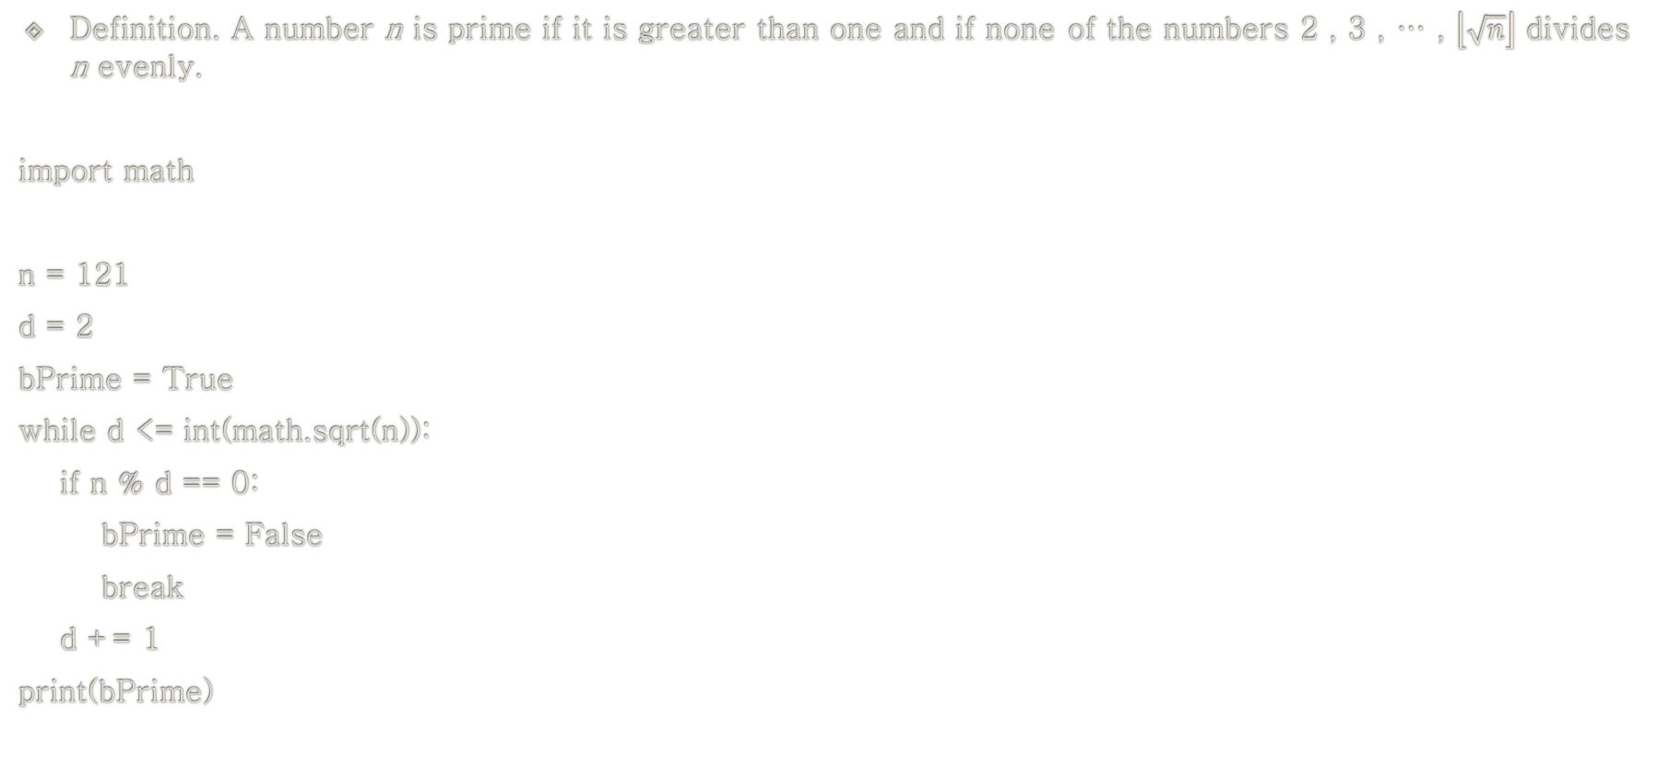
Example: while-if
Definition. A number n is prime if it is greater than one and if none of the numbers 2 , 3 , … , $\left\lfloor \sqrt{n}\right\rfloor$ divides n evenly.
import math
n = 121
d = 2
bPrime = True
while d <= int(math.sqrt(n)):
if n % d == 0:
bPrime = False
break
d += 1
print(bPrime)

Slide 124
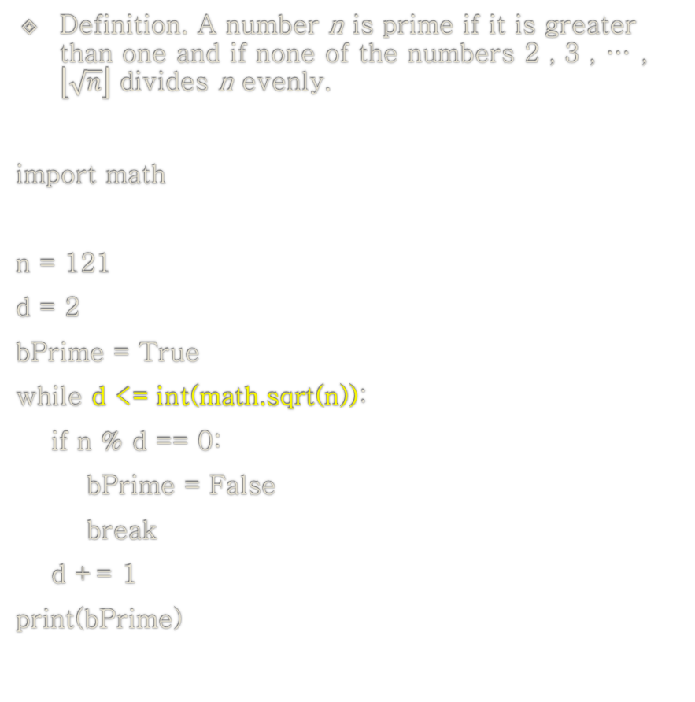
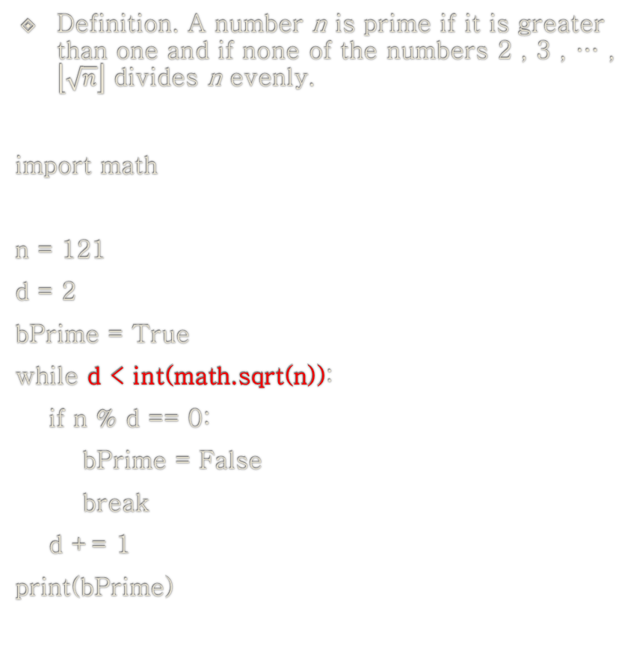
Example: while-if
Definition. A number n is prime if it is greater than one and if none of the numbers 2 , 3 , … , $\left\lfloor \sqrt{n}\right\rfloor$ divides n evenly.
import math
n = 121
d = 2
bPrime = True
while d < int(math.sqrt(n)):
if n % d == 0:
bPrime = False
break
d += 1
print(bPrime)
Definition. A number n is prime if it is greater than one and if none of the numbers 2 , 3 , … , $\left\lfloor \sqrt{n}\right\rfloor$ divides n evenly.
import math
n = 121
d = 2
bPrime = True
while d <= int(math.sqrt(n)):
if n % d == 0:
bPrime = False
break
d += 1
print(bPrime)

Slide 125
Example: while-if
Make a Python program which:
Step 1) inputs a string, s, representing a number.
Step 2) transforms s into an integer, n.
Step 3) prints out whether n is prime or not.

Slide 126
Example: while-if
import math
n = int(input("Type a number ... "))
d = 2
bPrime = True
while d <= int(math.sqrt(n)):
if n % d == 0:
bPrime = False
break
d += 1
print(bPrime)

Slide 127
Learning Objectives
while Statement
while
Control Flow in while Statement
Repetition Controls for while Statement
The break Statement
while-else
while-if
while-while (nested while)

Slide 128
Example: while-while (nested while)
i = 1
while i <= 10:
j = 1
while j <= 10:
print(j, end=", ")
j += 1
print()
i += 1
1, 2, 3, 4, 5, 6, 7, 8, 9, 10,
1, 2, 3, 4, 5, 6, 7, 8, 9, 10,
1, 2, 3, 4, 5, 6, 7, 8, 9, 10,
1, 2, 3, 4, 5, 6, 7, 8, 9, 10,
1, 2, 3, 4, 5, 6, 7, 8, 9, 10,
1, 2, 3, 4, 5, 6, 7, 8, 9, 10,
1, 2, 3, 4, 5, 6, 7, 8, 9, 10,
1, 2, 3, 4, 5, 6, 7, 8, 9, 10,
1, 2, 3, 4, 5, 6, 7, 8, 9, 10,
1, 2, 3, 4, 5, 6, 7, 8, 9, 10,

Slide 129
Example: while-while
i = 1
while i <= 10:
j = 1
while j <= 10:
if j < 10:
print(j, end=", ")
else:
print(j)
j += 1
i += 1
1, 2, 3, 4, 5, 6, 7, 8, 9, 10
1, 2, 3, 4, 5, 6, 7, 8, 9, 10
1, 2, 3, 4, 5, 6, 7, 8, 9, 10
1, 2, 3, 4, 5, 6, 7, 8, 9, 10
1, 2, 3, 4, 5, 6, 7, 8, 9, 10
1, 2, 3, 4, 5, 6, 7, 8, 9, 10
1, 2, 3, 4, 5, 6, 7, 8, 9, 10
1, 2, 3, 4, 5, 6, 7, 8, 9, 10
1, 2, 3, 4, 5, 6, 7, 8, 9, 10
1, 2, 3, 4, 5, 6, 7, 8, 9, 10

Slide 130
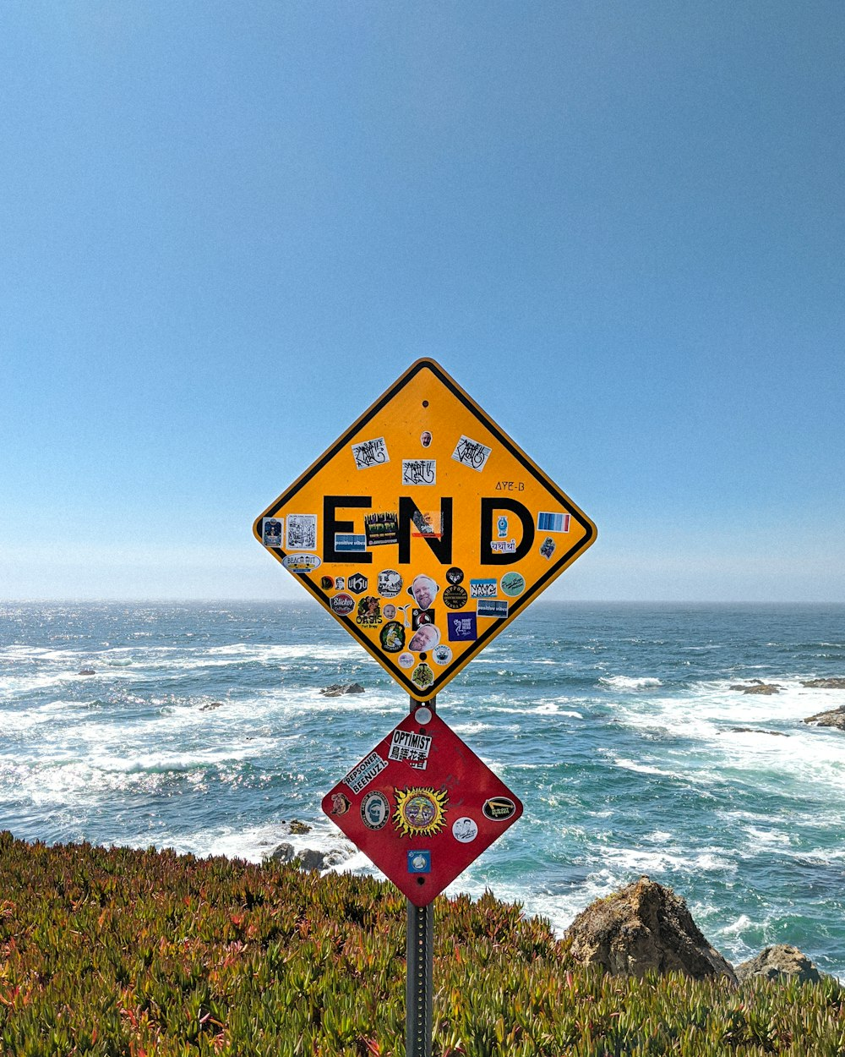
End of Python: Control Flow while Statement

